Slide 1





NEXT GEN EMPLOYABILITY PROGRAM
Creating a future-ready workforce
Team Members
College Name
Student Name :ponmani.P Student ID :au814721104040
SRM TRP Engineering college

Slide 2

CAPSTONE PROJECT SHOWCASE
Next Gen Employability Program
Project title
Notes Sharing Web Application using Django Framework
Abstract | Problem Statement | Project Overview | Proposed Solution | Technology Used | Modelling & Results | Conclusion

Slide 3
Next Gen Employability Program
Abstract
In the era of digital learning, the demand for efficient and secure platforms for document management in educational institutions is paramount. This project aims to develop a web-based platform that facilitates document exchange between students and teachers while ensuring ease of access, user-friendly interface, and robust security measures.
The platform will feature distinct login portals for students and teachers, each tailored to their specific needs. Students will be able to upload assignments, projects, and other relevant documents securely, while teachers will have the ability to review, grade, and provide feedback on these submissions. Additionally, teachers will be able to share course materials, announcements, and other resources with their students.
Source :

Slide 4
Next Gen Employability Program
Problem Statement
In the era of digital learning, the demand for efficient and secure platforms for document management in educational institutions is paramount. This project aims to develop a web-based platform that facilitates document exchange between students and teachers while ensuring ease of access, user-friendly interface, and robust security measures.
The platform will feature distinct login portals for students and teachers, each tailored to their specific needs. Students will be able to upload assignments, projects, and other relevant documents securely, while teachers will have the ability to review, grade, and provide feedback on these submissions. Additionally, teachers will be able to share course materials, announcements, and other resources with their students.
Source :

Slide 5
Next Gen Employability Program
Project Overview
Users can upload files to share with others and download files shared by others.Group Creation and Management: Users can create groups (e.g., classes or departments) and share files within these groups.Access Control: Files are accessible only to authorized users, ensuring security and privacy.Notifications: Users receive notifications for new file uploads, comments, or other relevant activities.Search Functionality: Users can search for files based on keywords, tags, or other criteria.User Profile: Users can view and manage their profile information, including uploaded
Source :

Slide 6
Next Gen Employability Program
Proposed Solution
This will help keep users informed and engaged with the platform.Search Functionality: Users can search for files based on keywords, tags, or other criteria, making it easy to find relevant materials quickly.Responsive Design: The application will have a responsive design, ensuring that it is accessible and usable on a variety of devices, including desktops, laptops, tablets, and smartphones.Overall, the proposed solution aims to provide a user-friendly and efficient platform for students and teachers to share files, enhancing collaboration
Source :

Slide 7
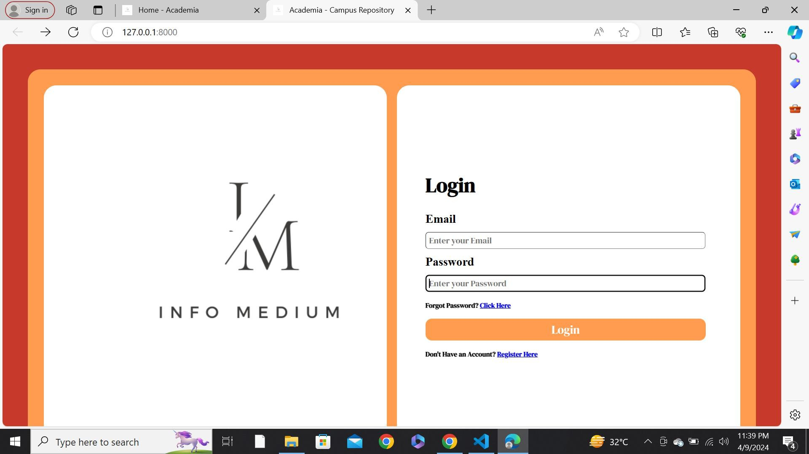
Next Gen Employability Program
Login:
Source :

Slide 8
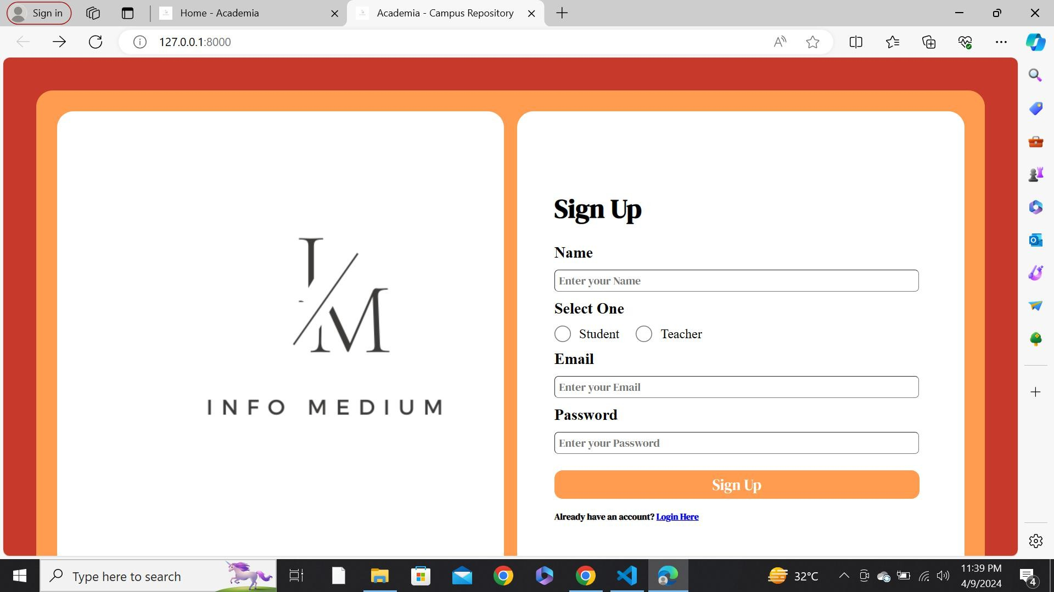
Next Gen Employability Program
signup

Slide 9
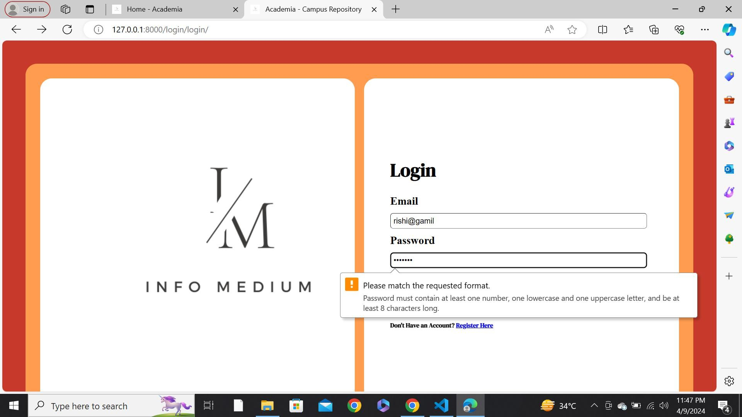
Next Gen Employability Program
error notification

Slide 10
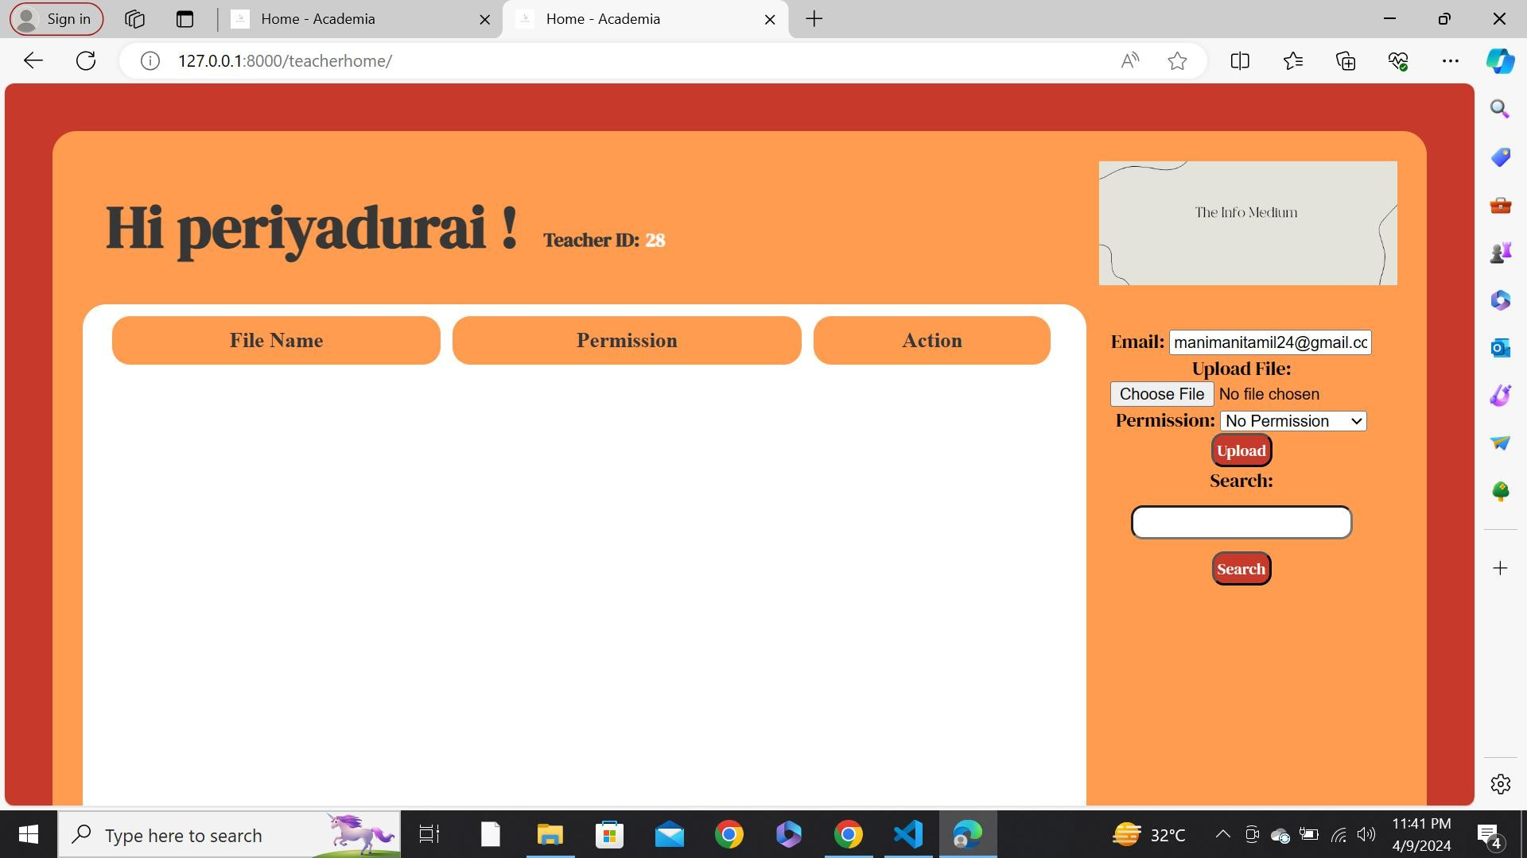
Next Gen Employability Program
teacher login

Slide 11
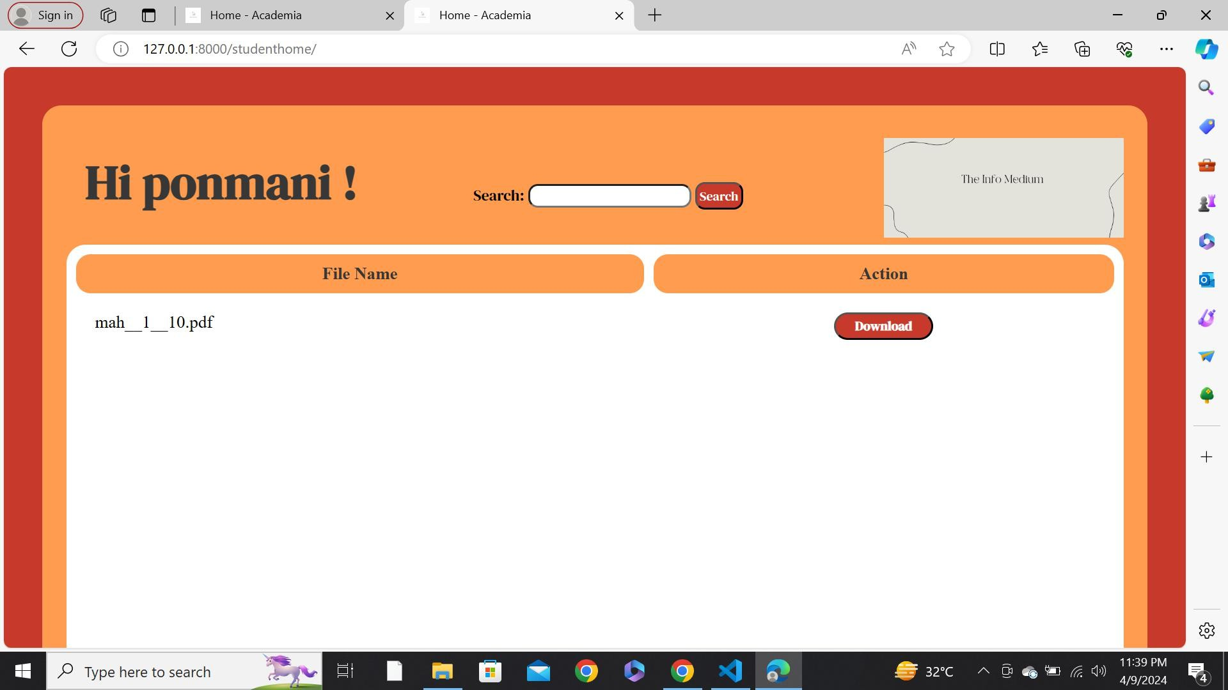
Next Gen Employability Program
student login
Source :

Slide 12
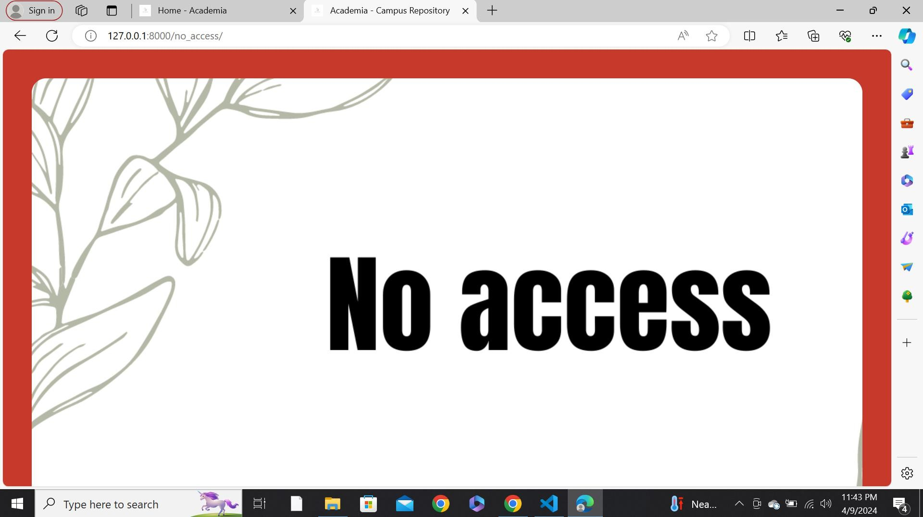
Next Gen Employability Program
No access

Slide 13
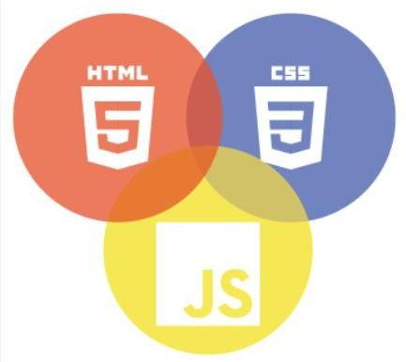

Next Gen Employability Program
Technology Used
Front-end
Back-end
Source :

Slide 14
Next Gen Employability Program
Modelling & Results
Make the content interactive and engaging to maintain learner.it offers flexibility in terms of scheduling,allowing learners to study at their own pace and convenience.reflect on your learning process regularly.
Source :

Slide 15
Next Gen Employability Program
Future Enhancements:
Real-time Collaboration: Implement features for real-time collaboration on documents, such as simultaneous editing and commenting.Advanced Search: Enhance the search functionality with filters, sorting options, and the ability to search within file contents.Integration with Learning Management Systems (LMS): Integrate the application with popular LMS platforms to streamline file sharing within existing educational workflows.File Versioning: Implement version control for files, allowing users to track changes and revert to previous versions if needed.

Slide 16
Next Gen Employability Program
Conclusion
In conclusion, the development of a web application for file sharing between students and teachers using Django offers a valuable solution to enhance collaboration and efficiency in educational settings. By providing a centralized platform for uploading, downloading, and managing files, the application streamlines the file-sharing process and improves organization.
Source :

Slide 17
Thank You!
Next Gen Employability Program

